Slide 1


Edge Computing and Networking for Future Telecommunication Systems
Guilherme Iecker Ricardo
Postdoctoral Researcher
ROC – CEDRIC - CNAM

Slide 2










Short Bio
Université Paris Dauphine, France
Computer Networks, L3 and M1
UFRJ, Brazil
Penn State, USA (BSMP)
Université Côte d’Azur, France
Inria SAM / EURECOM
Lecturer
To date
B.Eng.
2016
M.Sc.
2018
Ph.D.
2021
Postdoc
2023
Coppe/UFRJ, Brazil
Research Engineer, RNP, Brazil
Orange Labs, France
MORE Department
Postdoc
To date
CNAM, France
CEDRIC - ROC
Guilherme I. Ricardo - Short Bio.
1

Slide 3
Motivation and General Introduction

Slide 4
5G+/6G Systems Challenges
eMBB
Augmented Reality Applications
Cloud Gaming
5G+/6G
mMTC
URLLC
URLLC
Industrial Internet of Things
Smart Highways
Smart Cities
Remote medical procedures
Guilherme I. Ricardo – Telecommunication Systems Challenges
3
Notes:
1. Add back the animation
2. replace figures with standalone images
3. include green and intelligent words?

Slide 5




What is the Edge?
Internet’s Edge
Radio Access Nets
(RAN)
Cloud
Servers
Edge
Router
BS
Internet’s
Core
AP
ISP Access Nets
User Equipment (UEs)
Home/Institutional Local Nets
Guilherme I. Ricardo – Where is the Edge?
4
Notes:
1. This slide is supposed to be the definition of edge.
2. I have to
(1) include the host icons and show new names (check orange presentation)
(2) add a transparent square with the benefits of the edge paradigm

Slide 6

ECN as an Enabling Technology
Mobile Edge Orchestrator (MEO)
Cloud
Servers
Edge
Router
BS
Internet’s
Core
AP
User Equipment (UEs)
Far-Edge
Hosts
Near-Edge
Hosts
Guilherme I. Ricardo - (Mobile) Edge Computing as an Enabling Technology
5
Notes:
This slide is a placement for the slide with the transparent square

Slide 7
How does ECN help address 5G+/6G challenges?
URLLC
Application end-points proximity
- Reduced end-to-end latency
- Data center network and cloud servers offload
Edge Network Engineering
mMTC
eMBB
- Scalable, efficient resource management
- Low-cost, “green” deployments
URLLC
mMTCeMBB
In-Edge Artificial Intelligence
- Intelligent, data-oriented network control
- Enables cross-domain use cases (e.g., smart cities)
Guilherme I. Ricardo - How does MEC help address 5G+/6G challenges?
6
Notes:
This slide is a placement for the slide with the transparent square

Slide 8
ECN for PHY-Aware Caching

Slide 9
ECN for Task Distribution

Slide 10
Example 1: Task Distribution in MEC Networks
BS
Set of Tasks
AP
Unique UE-PoC
Association
Task Deployment
Network Flows
Definition
Guilherme I. Ricardo - How does MEC help address 5G+/6G challenges?
6
Notes:
This slide is a placement for the slide with the transparent square

Slide 11
Example 1: Task Distribution in MEC Networks
Requests
Arrival
Decision
Period
BS
n
n+1
Service
Period
AP
Priority Assignment
Sequencial Decision Problem
Flow Assignment
(Routing + Provider)
Discrete
Time
0
1
2
3
...
N-1
N
Guilherme I. Ricardo - How does MEC help address 5G+/6G challenges?
6
Notes:
This slide is a placement for the slide with the transparent square

Slide 12
Example 1: Task Distribution in MEC Networks
States
Target
Provide tasks with highest possible throughput
Solution Strategy
Question
Optimization Model
How to achieve that considering strict latency and other system’s requirements?
Betweenness-Flow Approximation
Challenges
Greedy and Streaming Heuristics
1. Trade off: Throughput x Latency
2. Temporal evolution
3. Processing and link capacities
4. Randomness behind request
Two-Time-Scale Optimization
Guilherme I. Ricardo - How does MEC help address 5G+/6G challenges?
6
Notes:
This slide is a placement for the slide with the transparent square

Slide 13
ECN for RAN Disaggregation

Slide 14
ECN for RAN Disaggregation: Principles
Service Request
Associated CU, DU, and RU
BS
Disaggregation
Centralized Unit
CU
AP
Distributed Unit
DU
Radio Unit
RU
Guilherme I. Ricardo - How does MEC help address 5G+/6G challenges?
6
Notes:
This slide is a placement for the slide with the transparent square

Slide 15
ECN for RAN Disaggregation: CU-DU-RU Placement
Mobile Edge Orchestrator (MEO)
Centralized Unit
CU
BS
Distributed Unit
DU
Radio Unit
RU
AP
Guilherme I. Ricardo - How does MEC help address 5G+/6G challenges?
6
Notes:
This slide is a placement for the slide with the transparent square

Slide 16
ECN for RAN Disaggregation: Solutions
States
Target
Provide tasks with highest possible throughput
Solution Strategy
Question
Optimization Model
How to achieve that considering users’ requirements and real-time decisions?
DL-based Decision Model
States
Target
Challenges
Reinforcement Learning
Maximum user admission considering network resources and system’s limitations.
1.
2. Temporal evolution
3. Processing and link capacities
4. Randomness behind request
Guilherme I. Ricardo - How does MEC help address 5G+/6G challenges?
6
Notes:
This slide is a placement for the slide with the transparent square

Slide 17
ECN for Federated Learning

Slide 18

ECN for Federated Learning: How does it work?
Mobile Edge Orchestrator (MEO)
Local models’ parameters
BS
AP
Guilherme I. Ricardo - How does MEC help address 5G+/6G challenges?
6
Notes:
This slide is a placement for the slide with the transparent square

Slide 19
ECN for Federated Learning: Data and Tasks
Examples of data
Example of Targets
Achieved throughput
UE-BS Association
Number of packets
CU-DU-RU Placement
Experienced latency
Task and File Distribution
Guilherme I. Ricardo - How does MEC help address 5G+/6G challenges?
6
Notes:
This slide is a placement for the slide with the transparent square

Slide 20
ECN for Federated Learning: Challenges
States
Target
Provide a reliable Federated Learning framework for data-oriented optimal network control
Challenges
1. ML models compatible with limited devices
2. Parameter selection for efficient training
3. Feasible solutions guarantee
4. Identifying and handling anomalies
New research directions!
States
Target
Maximum user admission considering network resources and system’s limitations.
Guilherme I. Ricardo - How does MEC help address 5G+/6G challenges?
6
Notes:
This slide is a placement for the slide with the transparent square

Slide 21
A more detailed example: Edge Caching

Slide 22
Edge Caching – Setup and Components
Catalog of files
MEO
Partial replication
Full provision
Backhaul
Network
Cloud
Servers
Internet’s
Core
Files have “popularity”
BSs store a fraction of catalog
Goal: retrieval delay (URLLC)
Primary characteristics
Small-Cell Base Stations (BSs)
Guilherme I. Ricardo - Edge Caching - Setup and Components
8

Slide 23
Edge Caching – CoMP-based Operation
Request (u2, f4):
Important Relation
Case I: Cache Miss
MEO
Backhaul
Network
Cloud
Servers
Request (u2, f2):
Case II: Cache Hit
Internet’s
Core
Request (u2, f1):
Case III: Multiple Hits
Guilherme I. Ricardo - Edge Caching - CoMP-based Operation
9

Slide 24
Problem Overview and Frameworks
Centralized decisions (e.g., MEO)
Global network information
Average performance optimization
Two stages: Placement + Provision
Centralized, Static Framework [2,3]
Question: How to manage caches in order to provide files with the smallest delay possible?
Challenges:
  Catalog size vs. cache capacity
  Randomness behind requests
  UE-BS topological organization
  Definition of the delay model
Individual decisions (BSs)
Limited network information
Local performance gain decisions
Adaptive policies
Distributed, Online Framework [3-5]
Guilherme I. Ricardo - Problem Overview and Frameworks
10
Notes:
Centralized = Caching problem (File placement)
Distributed =

Slide 25
Centralized, Static Framework [1, 2]
File Allocation Optimization Problem
Minimize retrieval delay averaged over all possible requests
File allocation must satisfy caches’ capacity constraint
Binary variables indicating whether BS b caches file f or not
Characteristics
Non-convex
Non-linear
NP-Hard
Submodular
Guilherme I. Ricardo – Centralized, Static Framework
11
Notes:
Centralized = Caching problem (File placement)
Distributed =

Slide 26
Distributed, Online Framework [3, 4]
Cache = Priority queue
Least-Recently-Used (LRU) core
Cache update operations:
Adaptive, Online Policy: qLRU-Δ
LRU cache implementation (at BS b)
MTFs
Insertions
Evictions
Insertion/Eviction
...
Front
(MRU)
Rear
(LRU)
Move-to-the-Front (MTF)
Guilherme I. Ricardo – Distributed, Online Framework
12
Notes:
Centralized = Caching problem (File placement)
Distributed =

Slide 27
qLRU-Δ: Probabilistic Cache Updates
Case 1
Case 2
Initial
State
Initial
Allocation:
1
2
3
Initial
Allocation:
4
1
2
Insertion/Eviction
Upon cache miss
Event
Request (u,4)
Cache Miss
Request (u,2)
Cache Hit
Probability
Probability
Move-to-the-Front (MTF)
Upon cache hit
Prob. proportional to delay reduction, i.e.,
Action
Move to the Front (MTF)
Insertion/Eviction
4
1
2
3
2
4
1
2
Final
State
Resulting
Allocation:
4
1
2
Resulting
Allocation:
2
4
1
Guilherme I. Ricardo – qLRU-Δ:Probabilistic Cache
13
Notes:
Centralized = Caching problem (File placement)
Distributed =

Slide 28
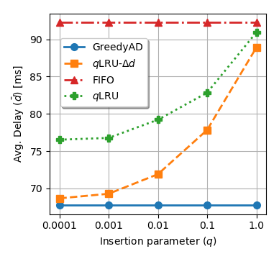
qLRU-Δ: Probabilistic Cache Updates
Case 1
Case 2
Initial
State
Initial
Allocation:
1
2
3
Initial
Allocation:
4
1
2
Insertion/Eviction
Upon cache miss
Parameter q
Event
Request (u,4)
Cache Miss
Request (u,2)
Cache Hit
Probability
Probability
Move-to-the-Front (MTF)
Upon cache hit
Prob. proportional to delay reduction, i.e.,
Action
Move to the Front (MTF)
Insertion/Eviction
4
1
2
3
2
4
1
2
Final
State
Resulting
Allocation:
4
1
2
Resulting
Allocation:
2
4
1
Guilherme I. Ricardo – qLRU-Δ:Probabilistic Cache Updates
13
Notes:
Centralized = Caching problem (File placement)
Distributed =

Slide 29
Optimality of qLRU-Δ – Assumptions
IRM
We model the requests for files using the Independence Reference Model (IRM), where requests for different files are independent and follow a Poisson process with rate λ.
CTA
Instant cache capacity may be violated, so files are not evicted for new insertions. However, files have an associated timer, the Characteristic Time. When time is up, the file is evicted, even without insertions.
EA
Exponentialization Approximation (EA) allows us to simplify files’ dynamics as independent stochastic processes that can be represented by Continuous Markov Chains.
q→0
We assume that Insertion/Eviction probability is very small, tending to zero. By doing so, we produce a process where only really important files will be inserted.
Guilherme I. Ricardo - Optimality of qLRU-Δ - Assumptions
14
Notes:
Centralized = Caching problem (File placement)
Distributed =

Slide 30
Optimality of qLRU-Δ – Assumptions
IRM
We model the requests for files using the Independence Reference Model (IRM), where requests for different files are independent and follow a Poisson process with rate λ.
Optimality Result
CTA
Instant cache capacity may be violated, so files are not evicted for new insertions. However, files have an associated timer, the Characteristic Time. When time is up, the file is evicted, even without insertions.
Under IRM and considering CTA and EA, if q→0, then a network of qLRU-Δ caches converges to the optimal solution of the centralized, static optimization problem.
EA
Exponentialization Approximation (EA) allows us to simplify files’ dynamics as independent stochastic processes that can be represented by Continuous Markov Chains.
q→0
We assume that Insertion/Eviction probability is very small, tending to zero. By doing so, we produce a process where only really important files will be inserted.
Guilherme I. Ricardo - Optimality of qLRU-Δ - Assumptions
14
Notes:
Centralized = Caching problem (File placement)
Distributed =

Slide 31
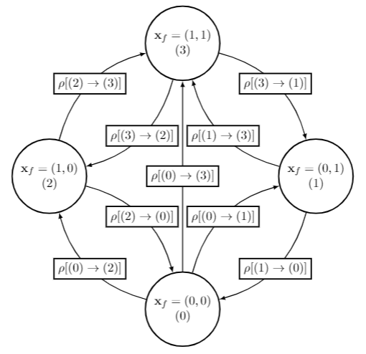
Optimality of qLRU-Δ – Intuition
States
States
All possible allocations for file f across all BSs in the network
Upward Transitions
Thinned request process with probability q
Downward Transitions
Thinned CTA eviction process with probability p
Guilherme I. Ricardo - Optimality of qLRU-Δ - Intuition
14
Notes:
Centralized = Caching problem (File placement)
Distributed =

Slide 32
Optimality of qLRU-Δ – Intuition
File Allocation (Relaxed) Problem
Stochastically Stable States
CTMC’s stationary distribution:
KKT Conditions
Guilherme I. Ricardo - Optimality of qLRU-Δ - Intuition
15
Notes:
Centralized = Caching problem (File placement)
Distributed =

Slide 33
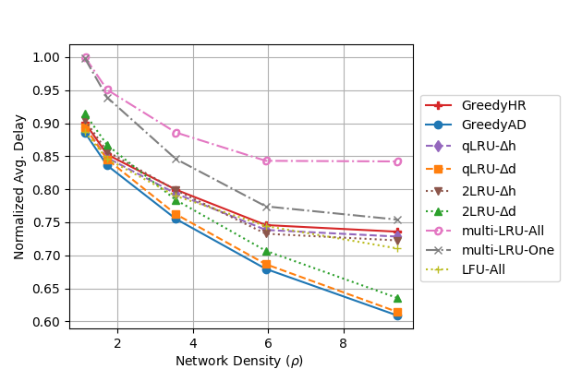
Optimality of qLRU-Δ – Intuition
File Allocation (Relaxed) Problem
Stochastically Stable States
CTMC’s stationary distribution:
KKT Conditions
Guilherme I. Ricardo - Optimality of qLRU-Δ - Intuition
15
Notes:
Centralized = Caching problem (File placement)
Distributed =

Slide 34
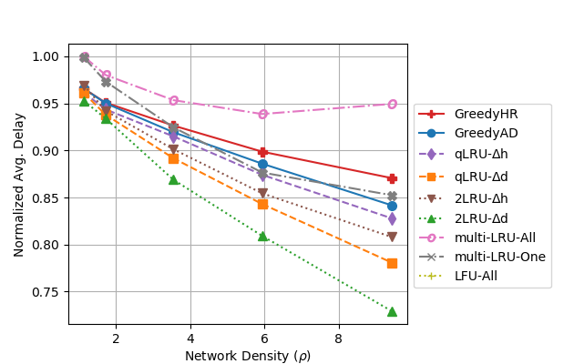
Performance of qLRU-Δ under more realistic setups
Guilherme I. Ricardo - Performance of qLRU-Δ under more realistic setups
16
Notes:
Centralized = Caching problem (File placement)
Distributed =

Slide 35
Final Remarks

Slide 36
Conclusions and Future Work
Edge Caching
Future Work (in general)
+ Flexible applicability (objectives)
+ Optimal convergence
+ Quick, responsive approach
- Convergence time
- Small q fails to capture variability
→New PHY-aware caching techniques
→Handling temporal locality
Responsive solutions for resource allocation and CU-DU-RU placement in future telecom architectures. For example:
→Online Learning
→Stochastic Optimization
→Machine Learning
Guilherme I. Ricardo – Conclusions and Future Work
16
Notes:
Centralized = Caching problem (File placement)
Distributed =

Slide 37
Thank you!
Questions?

Slide 38
References
[7] G. I. Ricardo, A. Benhamiche, N. Perrot, and Y. Carlinet, "Heuristic Distribution of Latency-Sensitive Tasks in Multi-Access Edge Computing Systems," in IEEE Global Communications Conference (GLOBECOM) NetMan6G Workshop, 2022.
[6] G. I. Ricardo, A. Benhamiche, N. Perrot, and Y. Carlinet, "Latency-Constrained Task Distribution in Multi-Access Edge Computing Systems," in IEEE International Conference on Cloud Networking (CLOUDNET).
[5] G. I. Ricardo, G. Neglia and T. Spyropoulos, "Caching Heterogeneous Size Content in Small Cell Networks
with CoMP Joint Transmissions," in IEEE Global Communications Conference (GLOBECOM), 2021.
[4] G. Neglia, E. Leonardi, G. I. Ricardo, T. Spyropoulos, "A Swiss Army Knife for Dynamic Caching in Small Cell Networks," in IEEE Transactions on Networking, 2021.
[3] G. I. Ricardo, A. Tuholukova, G. Neglia and T. Spyropoulos, "Caching policies for delay minimization in small cell networks with coordinated multi-point joint transmissions," in IEEE Transactions on Networking, 2021.
[2] G. I. Ricardo, G. Neglia and T. Spyropoulos, "Caching Policies for Delay Minimization in Small Cell Networks with Joint Transmissions," in IEEE International Conference on Communications (ICC), 2020.
[1] G. I. Ricardo, J. F. de Rezende and V. C. Barbosa, "Scheduling Wireless Links in the Physical Interference Model by Fractional Edge Coloring," in IEEE Wireless Communications Letters, 2020.
Notes:
TODO

